Slide 1
Information Retrieval (IR) Evaluation
Why Evaluation is Needed?
To measure system effectiveness
To compare ranking algorithms
To improve user satisfaction

Slide 2
Types of IR Evaluation
1. User-Based Evaluation
2. Test Collections (Offline Evaluation)
3. Online Evaluation Methods

Slide 3
Overall Evaluation Flow
Step 1: Build IR System
Step 2: Choose Evaluation Method
Step 3: Measure Performance
Step 4: Improve System

Slide 4
User-Based Evaluation - Overview
Focuses on real users
Measures satisfaction + usability
Best for understanding user experience

Slide 5
User Studies - Process Flow
Select group of users
Assign search tasks
Observe interaction
Measure time, clicks, success rat
Collect feedback

Slide 6
Advantages & Disadvantages - User Studies
Advantages: Realistic, detailed feedback
Disadvantages: Expensive, small sample size
Hard to repeat exactly

Slide 7
Surveys - Simple Evaluation
Ask users after search session
Rate relevance (1–5 scale)
Rate satisfaction
Subjective but easy to conduct

Slide 8
Offline Evaluation (Test Collections)
Based on Cranfield Paradigm
Uses predefined dataset
No real-time users involved

Slide 9
Components of Test Collection
1. Document Collection
2. Query Set
3. Relevance Judgments (Ground Truth)

Slide 10
Offline Evaluation Flow
Run system on query set
Retrieve ranked results
Compare with relevance judgments
Compute evaluation metrics

Slide 11
Important Evaluation Metrics
Precision: Relevant retrieved / Retrieved
Recall: Relevant retrieved / Total relevant
F1-Score: Balance of Precision & Recall
MAP: Mean Average Precision
NDCG: Ranking quality measure

Slide 12
Example
Text REtrieval Conference (TREC)
It provides:
Standard datasets
Queries
Relevance judgments
Researchers compare systems using same data.

Slide 13
Advantages & Limitations - Offline
Advantages: Cheap, repeatable, comparable
Limitations: Does not measure real user behavior

Slide 14
Online Evaluation - Overview
Uses real users in live system
Measures actual behavior
Common in commercial search engines

Slide 15
A/B Testing - Flow
Split users randomly into Group A and B
Group A: Old algorithm
Group B: New algorithm
Compare CTR, time spent, conversions

Slide 16
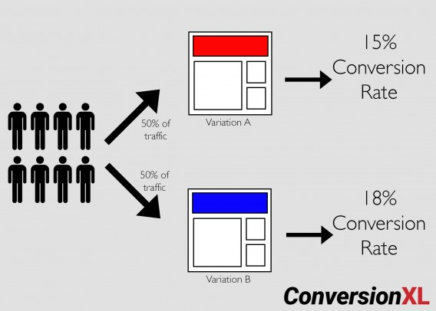

Slide 17
Advantages & Risks - A/B Testing
Advantages: Real-world validation
Statistically powerful
Risk: Bad version affects real users

Slide 18
Interleaving - Concept
Combine results from System A and B
Mix rankings into one list
Track which system gets more clicks

Slide 19
Interleaving - Why Useful?
Requires fewer users
Faster comparison
Sensitive to ranking differences

Slide 20
Comparison of All Methods
User Studies: Best for usability
Offline: Best for academic evaluation
A/B Testing: Best for large systems
Interleaving: Best for algorithm comparison

Slide 21
Final Understanding
No single method is enough
Offline + Online evaluation together
Continuous improvement is key in IR

